Slide 1

Acoustic emission techniques
By:
P.P.S.KEERTHI
Asst. Professor
Department of Mechanical Engineering
GVP College of Engineering(A)

Slide 2

What are Acoustic Emissions
High-frequency waves, at frequencies within the range 50 kHz to 10 MHz, are emitted when strain energy is rapidly released as a consequence of structural changes taking place within a material. Plastic deformation, phase transformations, twinning, micro-yielding and crack growth result in the generation of 'acoustic' signals which can be detected and analysed.

Slide 3
Principle of working
based on the generation of waves produced by a sudden redistribution of stress in a material
Forms of excitation- external load, change in pressure or temperature distribution
The so produced stress waves are propagated to the surface
Detection and analysis of AE signals give information regarding the origin and and importance of dislocations

Slide 4
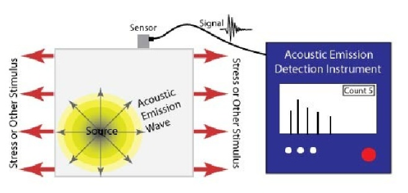

Slide 5
Types OF Acoustic Emission
Continous
Low amplitude
For plastic deformation and movement of dislocations within the material
Burst mode
High amplitude short duration pulses
For formation and growth of cracks within the body

Slide 6
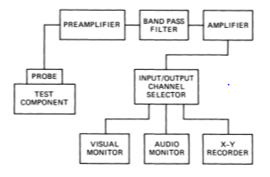
Working of AE techniques

Slide 7
when the wave front arrives at the surface, minute molecular movements occur on the surface.
A transducer placed on the surface will detect these signals and convert them into a electrical signal.
The commonly used transducer for this purpose are lead zirconium titanate element with a high electromechanical coupling coefficient
These signals are amplified and emitted as RF signal prescribed by different characteristics like amplitude, rise time, absolute energy

Slide 8
Then the signals are displayed by the waveform parameters for further analysis and interpretation
Usually a number of sensors are placed around the source and the time difference between the arrival of the signals is used to identify the location precisely.

Slide 9
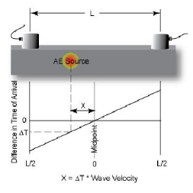
Different source location techniques
Multiple channel source location technique
Linear location technique

Slide 10
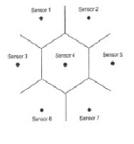
Zonal location technique
Point location technique

Slide 11
Instrumentation for AET
Sensors
Preamplifiers
Cables
Data Acquisition Device

Slide 12
Differences between AE and other NDT
Dynamic mode of testing
Usually a external load is not supplied unlike other NDT techniques
Loading should be high enough to make the flaws detected

Slide 13
Advantages and Limitations
Suitable for wide variety of materials
Change in the signal emitted with the growing discontinuity
can be applied to components in service
High sensitivity.
Early and rapid detection of defects, flaws, cracks etc
Cost Reduction
Minimization of plant downtime for inspection, no need for scanning the whole structural surface.

Slide 14
Provides only qualitative assessment
Further tests are required for quantitiative understanding

Slide 15
Applications
assessing structural integrity, detecting flaws, testing for leaks, or monitoring weld quality.
the detection of active corrosion in the bottom of above ground storage tanks, detecting creep damage in high energy piping (HEP) systems, pressure vessel inspection, and leak detection.
Can also be employed to monitor stress corrosion and corrosion fatigue failures

Slide 16
Petrochemical and chemical: storage tanks, reactor vessels, offshore platforms, drill pipe, pipelines, valves etc.
Electric utilities: nuclear reactor vessels, piping, steam generators, ceramic insulators, transformers, aerial devices.
Fiber-reinforced polymer-matrix composites, in particular glass-fiber reinforced parts or structures (e.g. fan blades)
Material research (e.g. investigation of material properties, breakdown mechanisms, and damage behavior)
Real-time leakage test and location within various components (small valves, steam lines, tank bottoms)

Slide 17
References
https://inspectioneering.com/tag/acoustic+emission
Text book: Barry Hull, Vernon John, Non Destructive Testing, McMillan Education
https://www.slideshare.net/Arahvinth/acoustic-emission-testing-olk
https://www.sciencedirect.com/topics/materials-science/acoustic-emission-testing

Slide 18
Thank you

